Slide 1


Escape Sequence in C Language
Escape sequences in C are special sequences of characters that are used to represent certain characters that cannot be directly typed or displayed. In this presentation, we will explore the various escape sequences defined in C and how to use them effectively.

Slide 2

The Significance of Backslash in C Escape Sequences
1
Escape Character
2
Used in Combination
The backslash acts as an escape character and indicates that the following character should be interpreted differently.
Backslash is used in combination with other characters to form escape sequences.

Slide 3
Escape Sequences used in C language
Character | usage
\n: Newline | Moves the cursor to the beginning of the next line.
\t: Horizontal Tab | Causes the cursor to skip to the next tab stop.
\v: Vertical Tab | Moves the cursor to the next vertical tab position.
\\: Backslash | Prints a literal backslash.
\': Single Quote | Prints a single quote character.
\": Double Quote | Prints a double quote character.
\a: Alert | Produces an audible or visible alert.
\?: Question Mark | Prints a question mark.
\0: Null Character | Represents the null character (ASCII value 0); often used in strings to denote the end of the string.

Slide 4
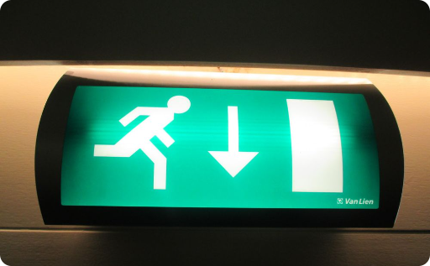


Examples of Commonly Used Escape Sequences in C
"\n"
"\t"
"\b"
Inserts a newline into the output, creating a new line.
Inserts a tab into the output, creating horizontal spacing.
Moves the cursor back one character, erasing the previous character.

Slide 5
Examples of Escape Sequences in C
\n
\t
\"
The following code will print "Hello" on one line, and "World" on the next:
The following code will print "Name: Alice" with a tab between "Name:" and "Alice":
For double quotes or single quotes in our string, we need to use the backslash character before the quote character to escape it:
printf("Hello\nWorld");
printf("Name:\tAlice");
printf("She said,\"Hello!\"\n");

Slide 6

How to Escape Escape Sequences in C
1
Double Backslash
Use two backslashes (\\) in a sequence to represent a single backslash.
2
Example
For example, to print a backslash character, use the sequence "\\\\".
3
Output
The output will be a single backslash: "\\".

Slide 7

Limitations of Using Escape Sequences in C
Complex Sequences
Language Specificity
Complex escape sequences can make code harder to read and understand.
Escape sequences may vary or have different interpretations in different programming languages.
Not All Characters Covered
Escape sequences do not cover all characters or situations, necessitating alternative approaches.

Slide 8

Conclusion
Escape sequences in C are powerful tools for representing special characters in string literals and character constants. While they provide flexibility, it's important to consider their limitations and ensure readability of code. Understanding and utilizing escape sequences effectively can enhance the clarity and functionality of your C programs.

